Slide 1
Evaluating Equity in the Formulation, Execution, and Impact of Public Policies:
A GUIDE FOR STAKEHOLDERS

Slide 2
Living standards have risen dramatically over the past 200 years.
But history and current global trends are overwhelmingly clear: growth alone is not enough to ensure a just distribution of incomes, assets, and opportunities.
Fortunately, governments have at their disposal policy instruments which can reduce economic and social injustice.

Slide 3
Governments using public policies to combat inequitable social outcomes often commit publicly to targets or national or international agreements.

Slide 4


















MOTIVATION
For example:
Agreeing to the Sustainable Development Goals (2030) framework and the “Leave no one behind” promise written into that framework.

Slide 5

MOTIVATION
For example:
Writing equity goals into budgets, development
plans, or sectoral development strategies.

Slide 6

MOTIVATION
These public commitments make transparent the standards by which policies should be judged. However, goals and objectives are often independent, overlapping, and difficult to separate from one another.
Policymakers, citizens, and stakeholders urgently need transparent and easy-to-apply analytical tools that provide meaningful empirical information on the impact that public policy is having on equity, inequality, poverty, and opportunities.

Slide 7
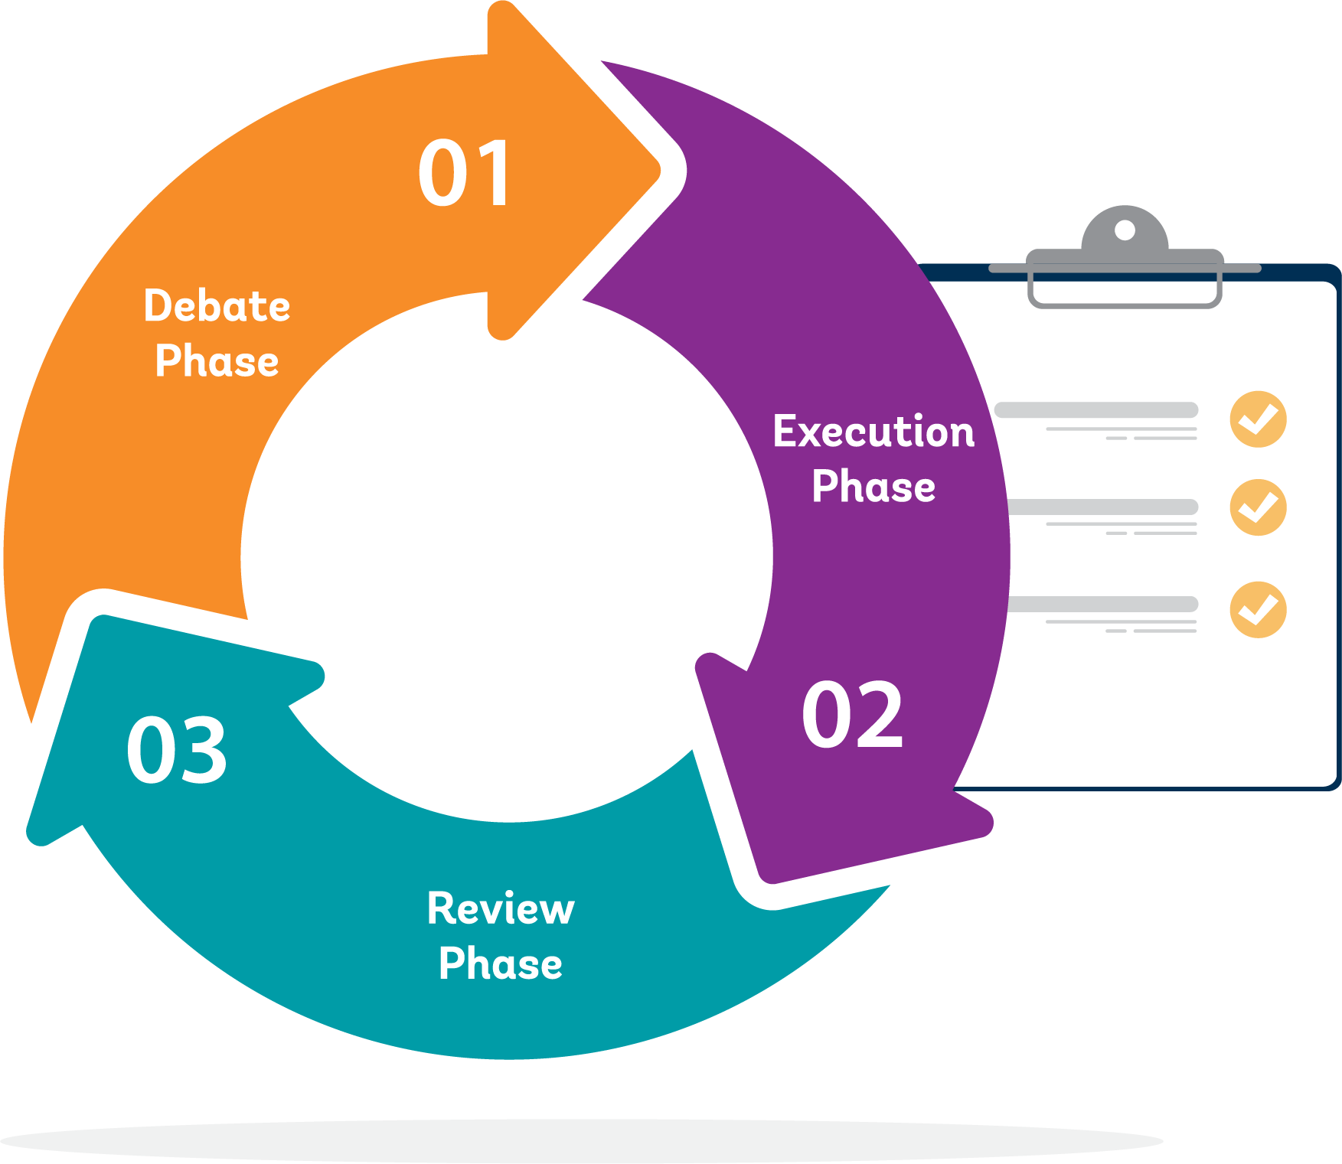

MOTIVATION
The cycle by which policies are turned into programs with social impact - a budget cycle or a development planning cycle - can be sketched in 3 continuous and overlapping processes

Slide 8
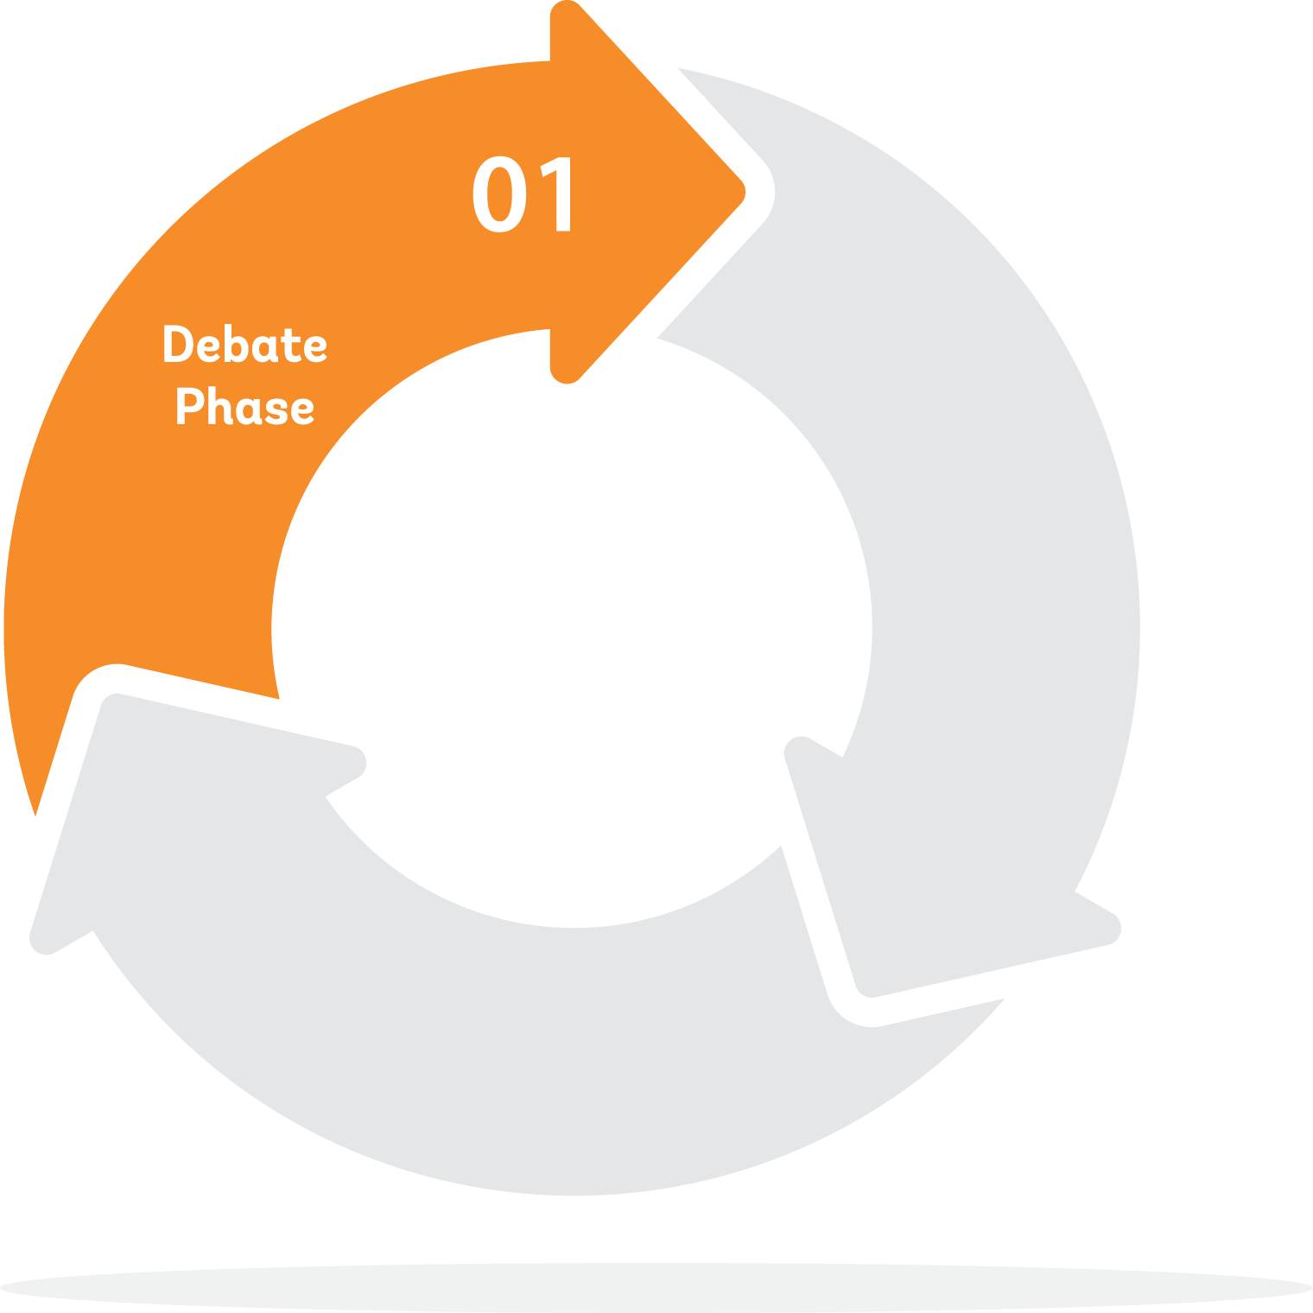



MOTIVATION
The debate and deliberation phase, where policy proposals are mooted and policy actors debate and agree on which policies to pursue.

Slide 9
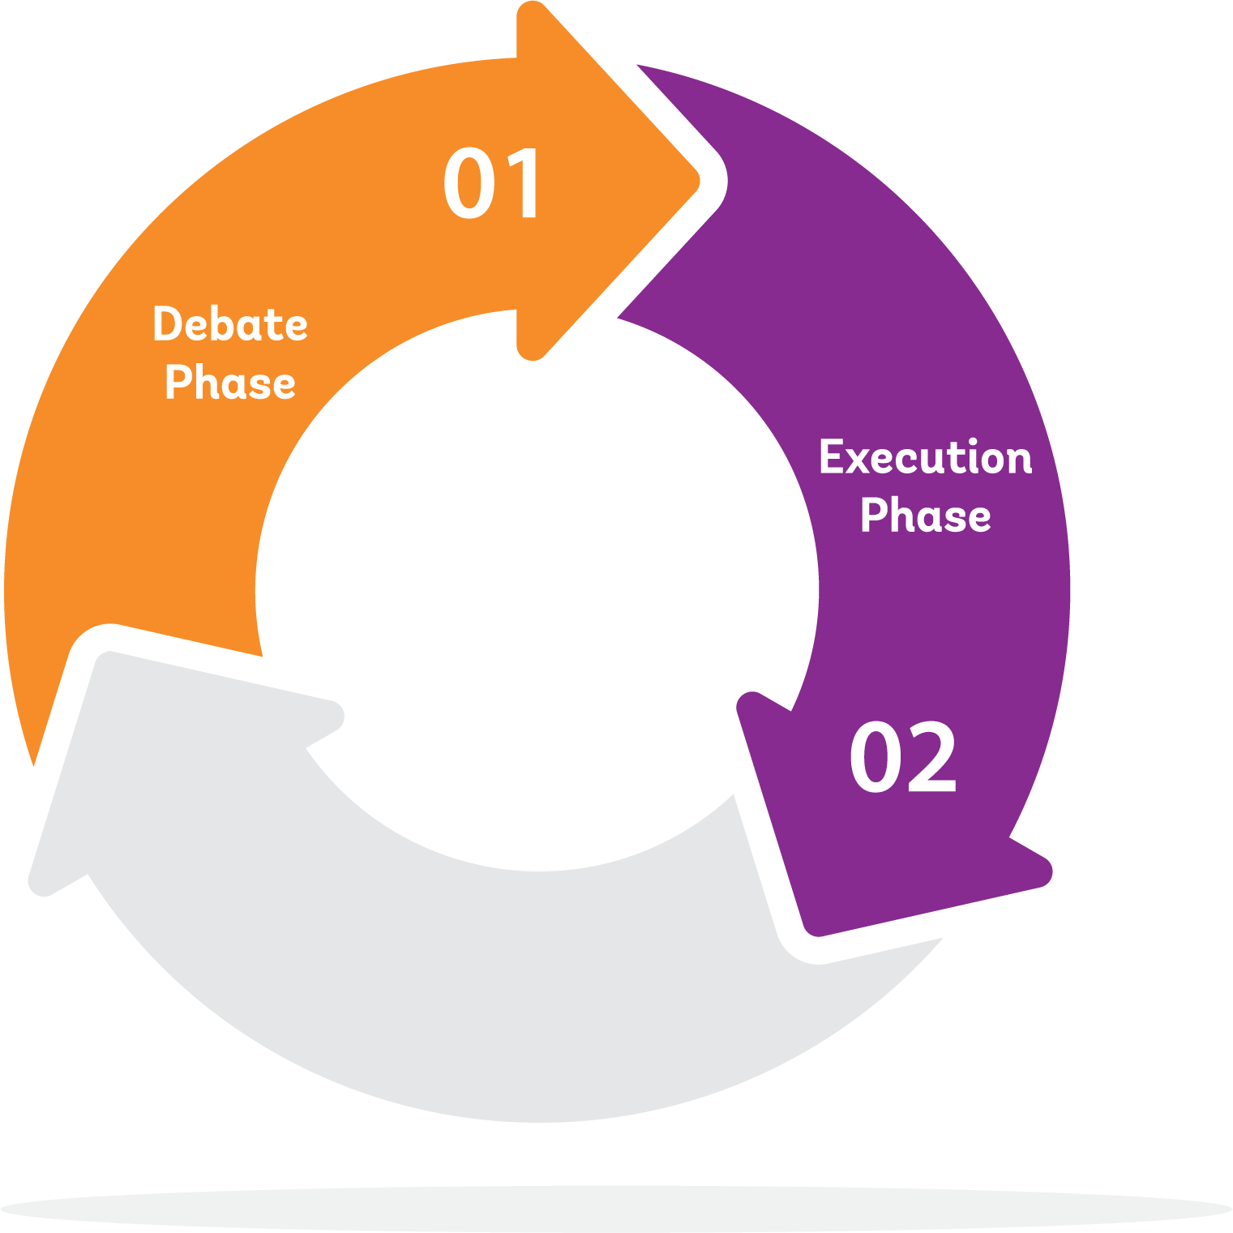

MOTIVATION
The debate and deliberation phase, where policy proposals are mooted and policy actors debate and agree on which policies to pursue.
The execution phase, where policies and programs are executed, budgets are disbursed by the fisc to executing agencies, and revenues are collected by the fisc.

Slide 10
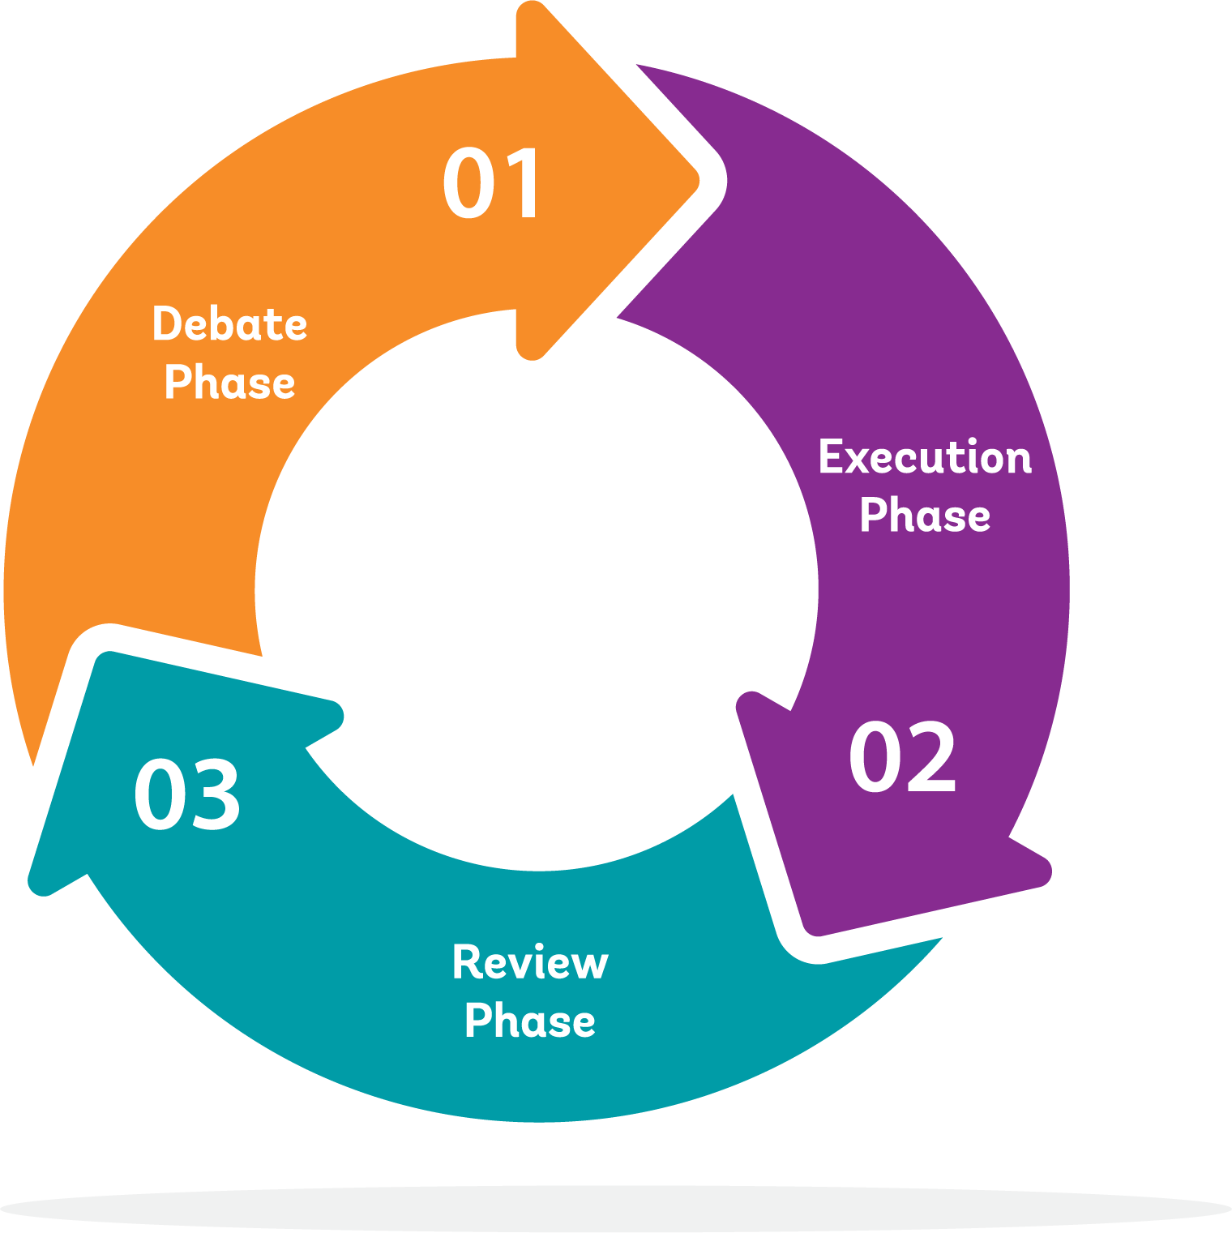

MOTIVATION
The debate and deliberation phase, where policy proposals are mooted and policy actors debate and agree on which policies to pursue.
The execution phase, where policies and programs are executed, budgets are disbursed by the fisc to executing agencies, and revenues are collected by the fisc.
The review phase, where evidence on the impact of policies (as executed) is produced, gathered, examined, debated and incorporated into the next cycle.

Slide 11

WHAT IS EBT?
The Equity Budgeting Tool (EBT)
Offers practitioners and policymakers a framework to analyze the extent to which reducing inequality is reflected in Phase 1 - the drafting and execution of public budgets.

Slide 12
WHAT IS EBT?
The EBT calls for a review of:
Primary data sources - annual budgets, national development plans and sectoral development strategies.
Secondary data sources - Public Expenditure and Financial Accountability (PEFA) assessments and Open Budget Surveys (OBS) - where they are available.

Slide 13
WHAT IS EBT?
EBT creates proprietary data, via stakeholder engagement, on the equity considerations built into budget and planning processes and procedures.
The EBT is therefore uniquely suited to reveal any political constraints limiting progress on equity goals.

Slide 14
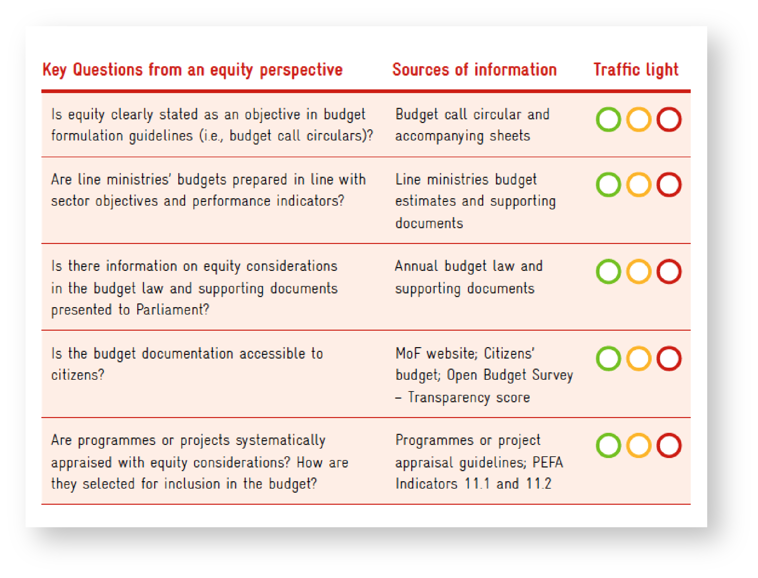
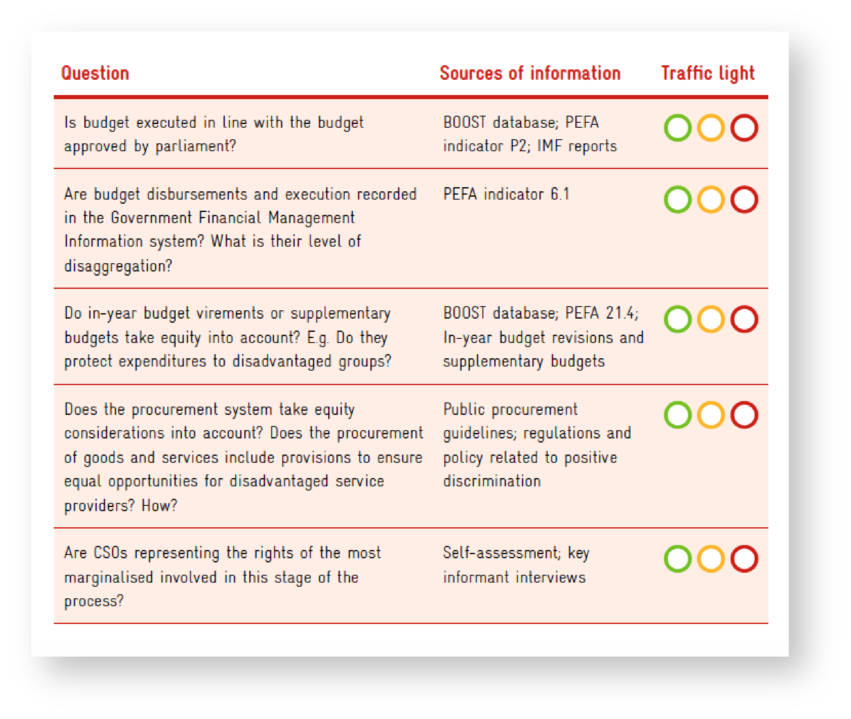
WHAT ARE EBT’S USEFUL RESULTS?
EBT analysis can show where and when equity principles, goals, and considerations are included in budget or development planning processes and budget execution.

Slide 15

*
HOW TO PRODUCE EBT’S USEFUL RESULTS
Creation of proprietary data through stakeholder interviews, workshops, and validation discussions.
Review and analysis of primary data in budgets, development plans, and sector strategies with stakeholders when possible.
Desk review and analysis of secondary data
and reporting.

Slide 16

WHAT DO WE NEED FOR RESULTS?
Primary / Proprietary Data
Stakeholder engagement, interviews, workshops
Household budget survey
Budgetary and administrative data on programs, taxes and expenditures
National Development plan
Sectoral Strategic plans
Secondary Data
PEFA or OBS
Public Expenditure Reviews

Slide 17
WHAT DO WE NEED FOR RESULTS?
Primary / Proprietary Data
Stakeholder engagement, interviews, workshops
Household budget survey
Budgetary and administrative data on programs, taxes and expenditures
National Development plan
Sectoral Strategic plans
Secondary Data
PEFA or OBS
Public Expenditure Reviews

Slide 18

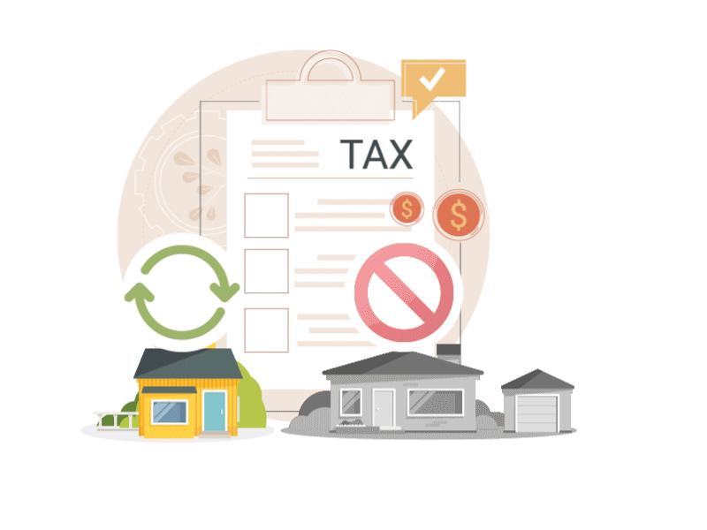
WHAT IS FIA?
Fiscal Incidence Analysis (FIA):
An estimate of the net impact that fiscal policies - taxes and transfers - have on each individual citizen, family, or household.
FIA allocates taxes to the individuals who pay them; and transfers to individuals eligible to receive them.

Slide 19
WHAT IS FIA?
Fiscal Incidence Analysis (FIA):
FIA allocates or assigns taxes and transfers to individuals responsible for paying them or eligible to receive them.
FIA traces the impact of fiscal policies from their execution by government down to individuals.

Slide 20
WHAT IS FIA?
Fiscal Incidence Analysis (FIA):
By summing up individual net impacts over all individuals, FIA provides an estimate of economy-wide impact of fiscal policy on equity indicators: inequality, poverty, fiscal impoverishment, progressivity, and others

Slide 21

WHAT ARE FIA’S USEFUL RESULTS?
FIA provides a summary of the different ways which different groups are made both better off and worse off by fiscal policy.
FIA can isolate the impact of individual policies or the impact of all policies on specific subgroups like the elderly or children, for example.
FIA accounts for the current impact of
current policies, however, by linking policies
to individuals, their characteristics, and their behaviors, FIA provides useful background information for estimates of the impact of
policy reform (or future policies)

Slide 22
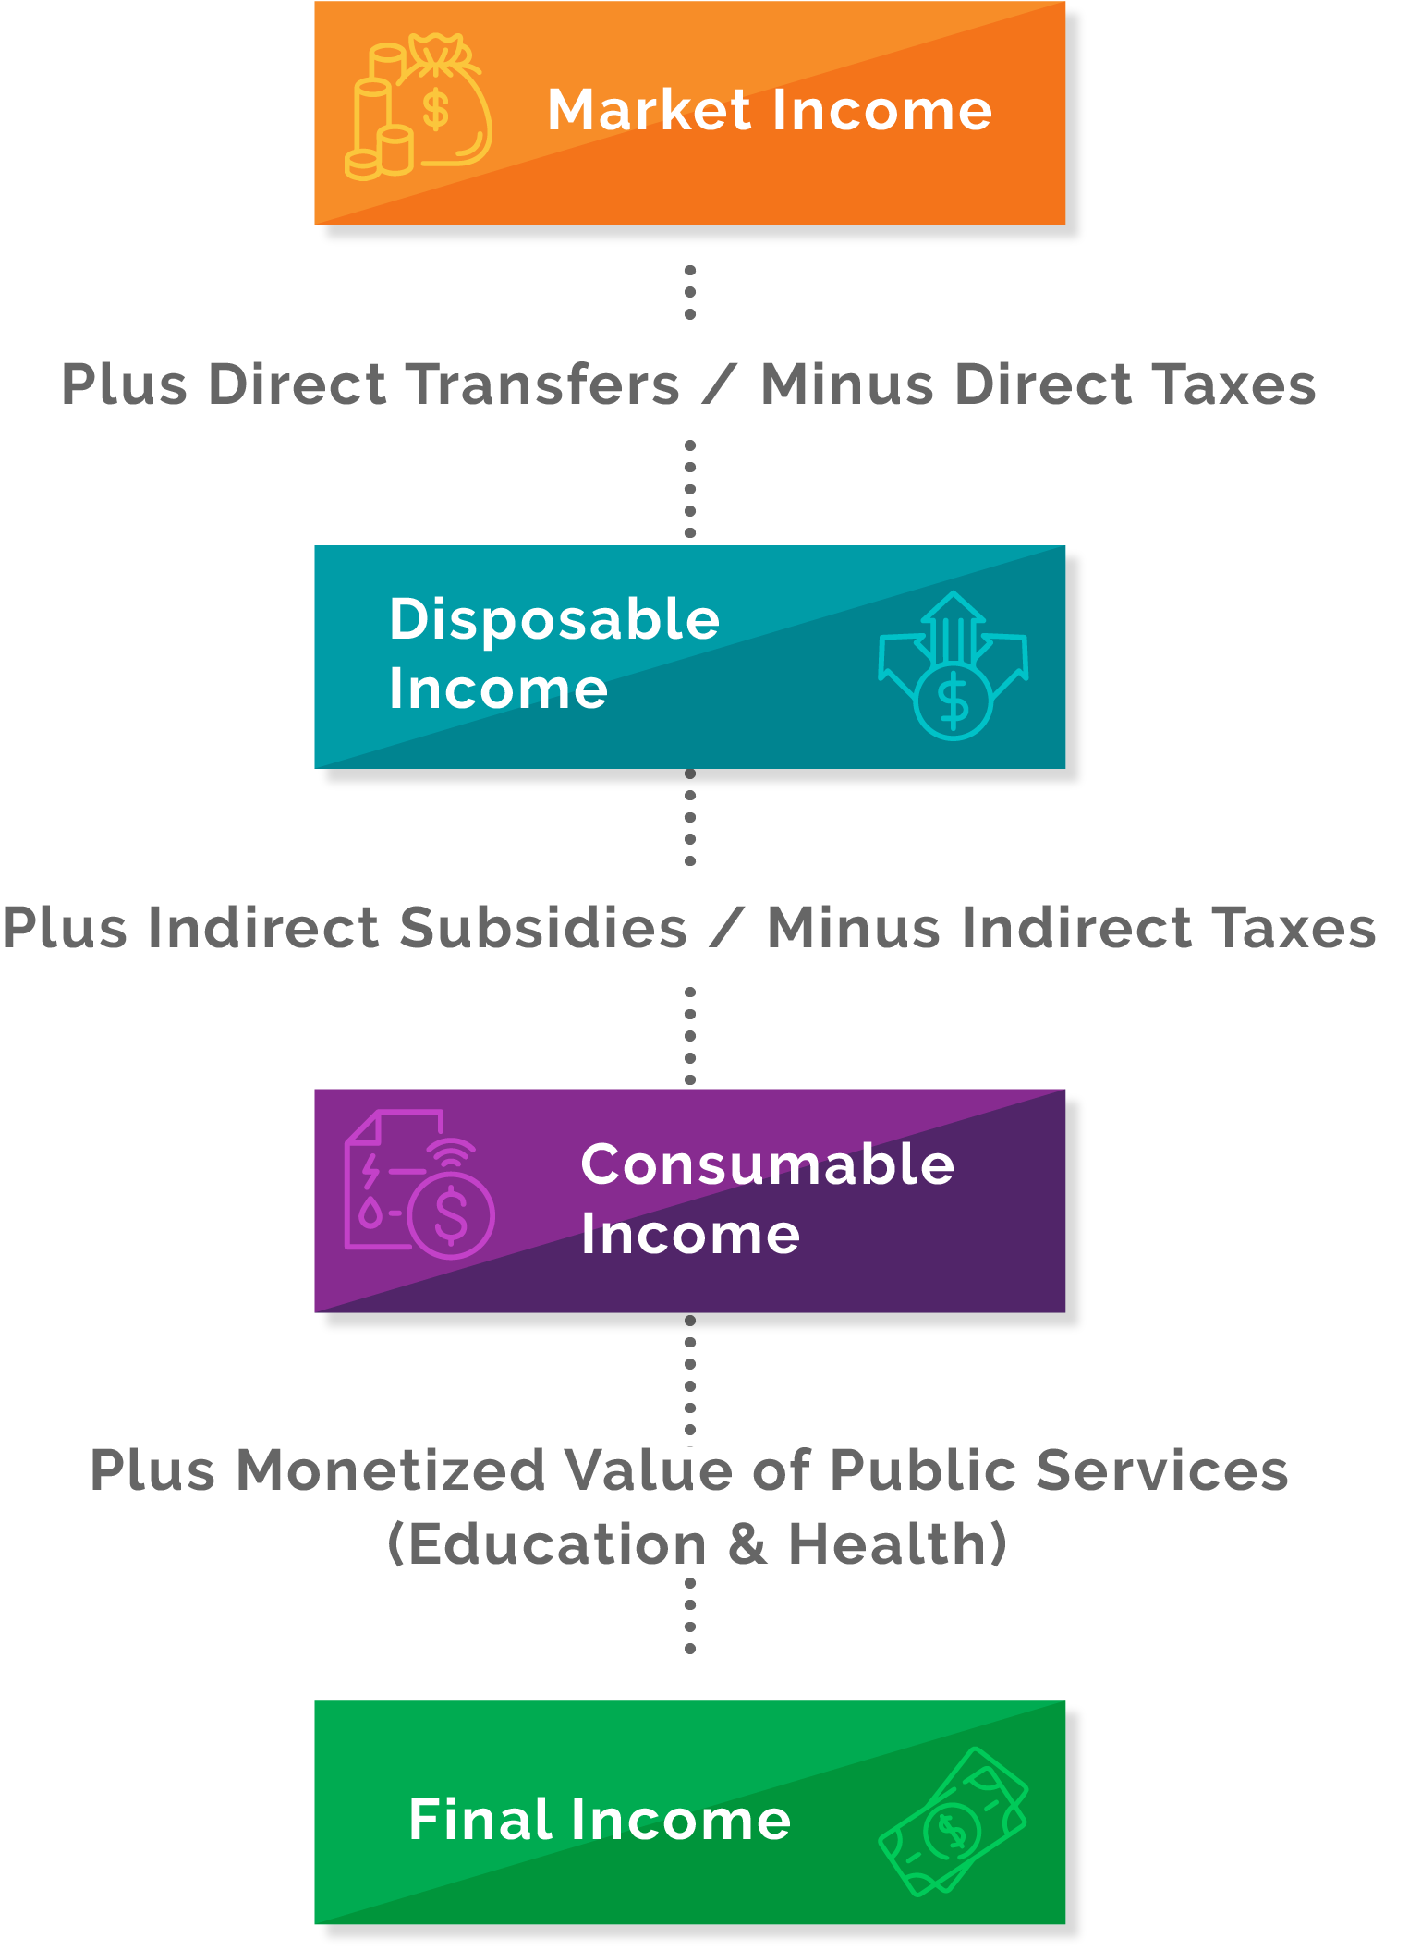
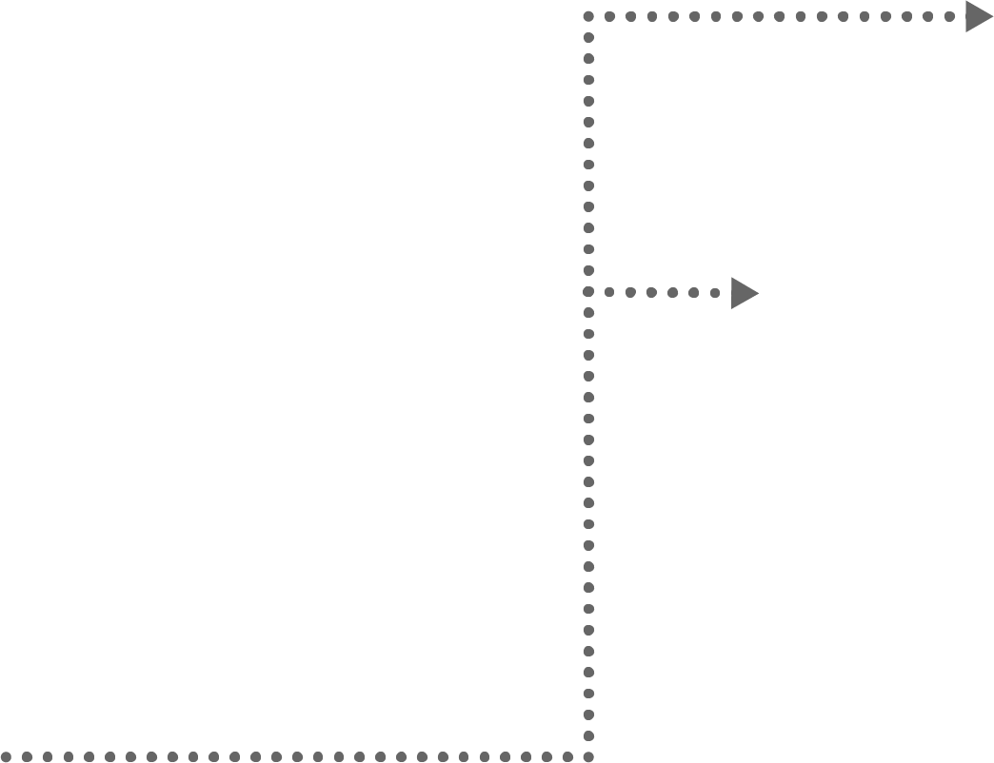
HOW DO WE GET RESULTS?
Conceptual Scheme
Organizing principle: How do individuals access/experience fiscal policy?
As suppliers of external labor
Fiscal elements:
  Income Taxes including tax credits
  and taxable income rules
  MSME finance
  Policies (like maternal/parental leave)
  that address wage gaps

Slide 23

HOW DO WE GET RESULTS?
Conceptual Scheme
Organizing principle: How do individuals access/experience fiscal policy?
As consumers
Fiscal elements:
  Direct Transfers – can target recipient/eligibility; can target control of benefit
  Indirect Taxes and Subsidies

Slide 24

HOW DO WE GET RESULTS?
Conceptual Scheme
Organizing principle: How do individuals access/experience fiscal policy?
As participants in Social Reproduction
Fiscal elements:
  In-kind transfers: Education; Health; Water, Sanitation,
  and Hygiene (WASH) services; childcare elderly care
  Infrastructure
  Communications/Internet
  and Media

Slide 25
HOW DO WE GET RESULTS?
Conceptual Scheme
Organizing principle: How do individuals access/experience fiscal policy?
As investors in human capital
Fiscal elements (continued):
  Labor-market activation
  Provision of housing and
  other assets

Slide 26

HOW DO WE GET RESULTS?
Individuals experience
fiscal policy:
As suppliers of external labor
As consumers
As participants
in Social Reproduction
As investors in human capital
“Adding up” all individual impacts of policy
allows estimation of the fiscal impact on society as a whole, as well as priority populations such as the poor and vulnerable or those in danger of being left behind

Slide 27
WHAT DO WE NEED FOR RESULTS?
Primary / Proprietary Data
Stakeholder engagement, interviews, workshops
Household budget survey
Budgetary and administrative data on programs, taxes and expenditures
National Development plan
Sectoral Strategic plans
Secondary Data
PEFA or OBS
Public Expenditure Reviews

Slide 28
WHAT DO WE NEED FOR RESULTS?
Primary / Proprietary Data
Stakeholder engagement, interviews, workshops
Household budget survey
Budgetary and administrative data on programs, taxes and expenditures
National Development plan
Sectoral Strategic plans
Secondary Data
PEFA or OBS
Public Expenditure Reviews

Slide 29


WHAT ARE POLICY MICROSIMULATIONS?
Microsimulations provide a preview of equity impacts of potential policy reform.
When built on a context-specific fiscal incidence model, feasible policy reform scenarios can be costed and benefits can be validly compared.

Slide 30



WHAT IS ESSENTIAL IN SIMULATION TOOLS?
User interface:
Creating a friendly, approachable, intuitive design.
Applicability and policy relevance:
The tool should be able provide an empirical forecast regarding the impact of fiscal policy reforms that are relevant and feasible in the country in question.
Human Resources:
The simulation tool is a “use it or lose it” proposition – when there are no individuals able to manipulate the tool its relevance will fade.

Slide 31
WHAT DO WE NEED FOR RESULTS?
Primary / Proprietary Data
Stakeholder engagement, interviews, workshops
Household budget survey
Budgetary and administrative data on programs, taxes and expenditures
National Development plan
Sectoral Strategic plans
Secondary Data
PEFA or OBS
Public Expenditure Reviews

Slide 32
WHAT DO WE NEED FOR RESULTS?
Primary / Proprietary Data
Stakeholder engagement, interviews, workshops
Household budget survey
Budgetary and administrative data on programs, taxes and expenditures
National Development plan
Sectoral Strategic plans
Secondary Data
PEFA or OBS
Public Expenditure Reviews

Slide 33

EQUITY IMPACTS TEAM – WHO IS NECESSARY?
Lead: Analytical mastermind; convener
Co-lead: Departmental Liaison
Researchers: 1 to 2 individuals capable of producing analytics or translating analytics into policy action plans.

Slide 34
CONCLUSION
Committing public policies to improve equity is admirable; judging whether public policies are having the desired impact is not always obvious.
Positive progress on equity goals can be made in the processes which are followed to generate budgets, development plans, and in policy formulation…

Slide 35
CONCLUSION
…and in the execution of policies, programs, and plans, where the tangible benefits created from public policies reach individuals, and where individuals are asked to part with private resources (taxes) in order to partially fund those expenditures…
…and in the desire for reform when policies are having less of a positive equity impact than they should.

Slide 36
CONCLUSION
Equity analysis at all 3 phases allows governments to go beyond targets and indicators and provide context and forward-looking momentum for policy reform.

